Slide 1
Reading Centers
Name: ________________________ Week of: ______________
Type Center Name
To Do
Type Center Name
Type expectation here.
Type expectation here.
Type expectation here.
Type expectation here.
Type expectation here.
Type expectation here.
Type Center Name
To Copy
Type Center Name
______________________
Type expectation here.
Type expectation here.
Type expectation here.
Type expectation here.
Type expectation here.
Type expectation here.
©Jennifer Findley

Slide 2
Reading Centers
Name: ________________________ Week of: ______________
Type Center Name
To Do
Type Center Name
Must Do:
Must Do:
Type expectation here.
Type expectation here.
Type expectation here.
Type expectation here.
Type expectation here.
Type expectation here.
May Do:
May Do:
Type expectation here.
Type expectation here.
Type expectation here.
Type expectation here.
Type expectation here.
Type expectation here.
Type Center Name
Type Center Name
Must Do:
Must Do:
Type expectation here.
Type expectation here.
Type expectation here.
Type expectation here.
Type expectation here.
Type expectation here.
May Do:
May Do:
Type expectation here.
Type expectation here.
Type expectation here.
Type expectation here.
Type expectation here.
Type expectation here.
©Jennifer Findley

Slide 3
Reading Centers
Name: _______________________________________ Date: __________________
Name of Center | Center Expectations | Student Initials*
Type Center Name | Type Center Expectations Here
Type Center Name | Type Center Expectations Here
Type Center Name | Type Center Expectations Here
Type Center Name | Type Center Expectations Here
*Write your initials to indicate you have checked both the quality and quantity of your work for each center.

Slide 4
Reading Centers
Name: _______________________________________ Date: __________________
Type Center Name Here | Type Center Name Here | Type Center Name Here
Type Expectations Here | Type Expectations Here | Type Expectations Here
Student Self-Assessment I have completed all of the above work. I have checked to make sure the quality of the work I have completed meets expectations. I have checked my work for accuracy. | Student Self-Assessment I have completed all of the above work. I have checked to make sure the quality of the work I have completed meets expectations. I have checked my work for accuracy. | Student Self-Assessment I have completed all of the above work. I have checked to make sure the quality of the work I have completed meets expectations. I have checked my work for accuracy.

Slide 5
Reading Centers
Name: _______________________________________ Date: __________________
Type Center Name Here | Type Center Name Here | Type Center Name Here
Student Self-Assessment I have completed all of the above work. I have checked to make sure the quality of the work I have completed meets expectations. I have checked my work for accuracy. | Student Self-Assessment I have completed all of the above work. I have checked to make sure the quality of the work I have completed meets expectations. I have checked my work for accuracy. | Student Self-Assessment I have completed all of the above work. I have checked to make sure the quality of the work I have completed meets expectations. I have checked my work for accuracy.
Type Center Name Here | Type Center Name Here | Type Center Name Here
Student Self-Assessment I have completed all of the above work. I have checked to make sure the quality of the work I have completed meets expectations. I have checked my work for accuracy. | Student Self-Assessment I have completed all of the above work. I have checked to make sure the quality of the work I have completed meets expectations. I have checked my work for accuracy. | Student Self-Assessment I have completed all of the above work. I have checked to make sure the quality of the work I have completed meets expectations. I have checked my work for accuracy.
©Jennifer Findley

Slide 6
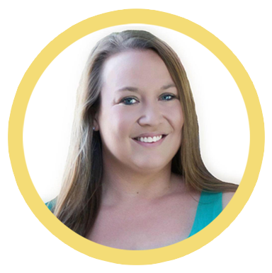



This resource was created by Jennifer Findley. It may be printed and photocopied for single classroom use. It may not be put on the Internet, sold, or distributed in any form. Check out my store for more resources that are common core aligned.
Follow my blog for updates and freebies.
Thanks!
Jennifer Findley

