Slide 1
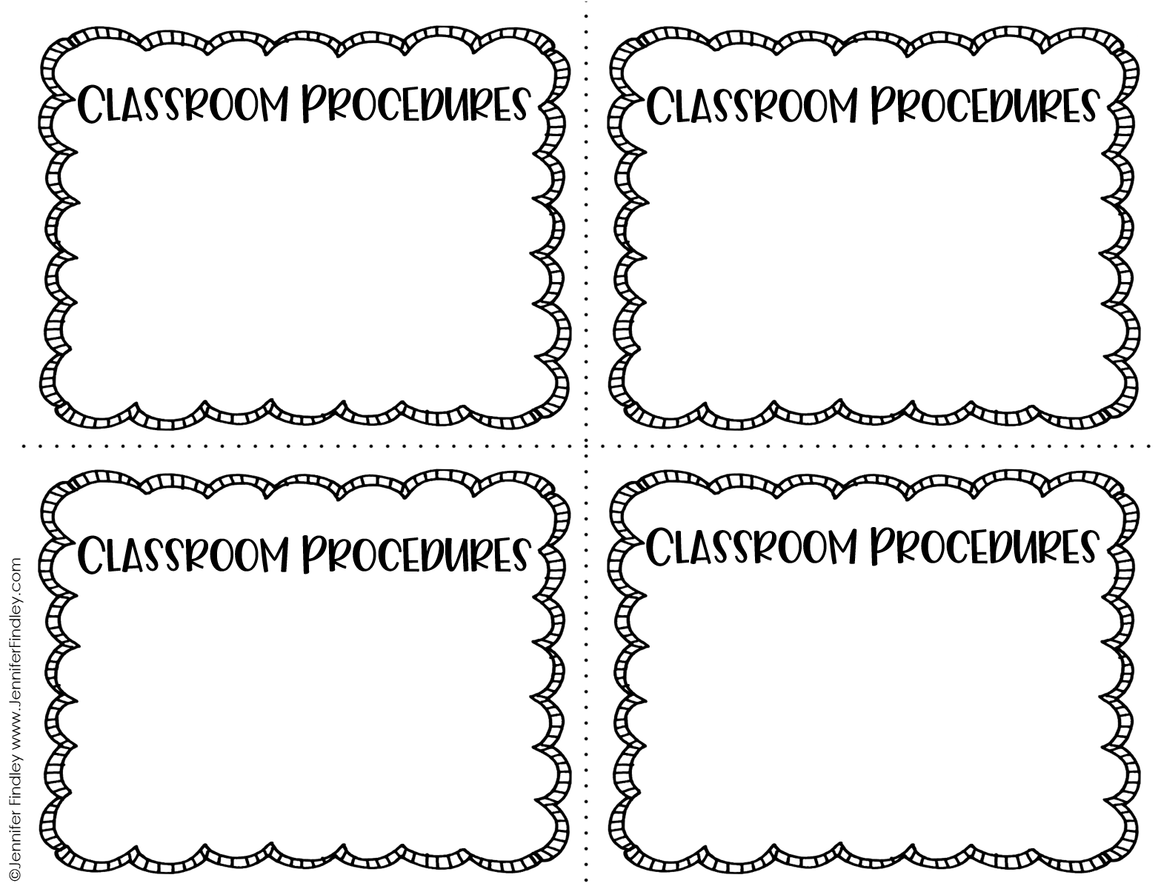
What do you do when you first enter the classroom in the morning?
What are the procedures for unpacking your book bag/backpack?
1
2
What to do you do with your completed homework?
What do you do if you have an important letter or note for the teacher?
3
4

Slide 2
What is the procedure for sharpening pencils in the morning?
What do you do if you need a pencil in the morning?
5
6
What do you do if you left something important (letter, homework, etc.) at home?
What do you do right when you get to your seat in the morning?
7
8

Slide 3
What do you need to do at the end of the day to prepare for dismissal?
When and how do you pack up
your book bag/backpack?
9
10
What are the procedures for cleaning and organizing your area at the end of the day?
How do you line up or exit the room for dismissal?
11
12

Slide 4
What do you do if you need a pencil/need to sharpen your pencil during class?
What do you do if you need a tissue during class?
13
14
How do you keep your supplies organized?
What do you do if you are not sure how to complete your assigned work?
15
16

Slide 5
What are the procedures for asking questions during class?
What are the procedures for joining a classroom discussion?
17
18
What do you do if you need to use the restroom?
What do you do if you need to go to your book bag/backpack during the day?
19
20

Slide 6
What are the procedures for turning in class work?
How do you label your class work (name, date, etc.)?
21
22
What are the procedures for changing subjects?
What are the procedures for eating and drinking in class?
23
24

Slide 7
What are the procedures when someone comes into the classroom from another classroom?
What are the procedures for when the class phone rings?
25
26
What do you do when you the teacher is working with another student or group of students?
What do you do if you get sick or hurt during class?
27
28

Slide 8
What do you do if you come in late?
What do you do if you were absent the day before?
29
30
What do you do if you finish work early?
How do you line up and exit the classroom?
31
32

Slide 9
What are the hallway procedures?
What are the restroom procedures when going as a class?
33
34
What are the important procedures for recess?
What are the procedures for the cafeteria?
35
36

Slide 10
What are the procedures for lining up at the end of recess?
How do you know when it is time for recess to be over?
37
38
What are the important safety rules and expectations when playing at recess?
What is the procedure for reporting problems or issues during recess?
39
40

Slide 11
Classroom procedures
Name: _____________________________________________________ Date:____________

Slide 12
This resource was created by Jennifer Findley. It may be printed and photocopied for single classroom use. It may not be put on the Internet, sold, or distributed in any form. Check out my store for more resources that are common core aligned.
Follow my blog for updates and freebies.
Thanks!
Jennifer Findley
www.JenniferFindley.com
Amy Groesbeck Fonts

