Slide 1
Reading Helper: Literature
Story Elements
Point of View
Figurative
Characters - the people or animals that are important to the story
Setting - the time and place of the events
Plot - the order of events in the story; usually revolves around a conflict or challenge
Point of View - the perspective from which the narrator or character tells the story
1st Person Point of View - when a character from the story is telling the story from his or her own experiences
3rd Person Point of View - when a narrator who is not part of the story is telling the story
Language
Figurative Language - any phrase that goes beyond its literal meaning
Simile - a type of figurative language that makes a comparison using like or as
Metaphor - a type of figurative language that makes a direct comparison
Personification - a type of figurative language that gives human qualities to a nonhuman object
Hyperbole - an extreme exaggeration
Theme
Theme - the life lesson that readers can learn and apply to their lives.
Readers learn lessons by thinking about how the characters react to goals, challenges, or conflicts in their lives.
Example Themes - Don’t give up on something that is important to you. Don’t judge people before you get to know them.
Context Clues
Context Clues - clues that readers use to determine the meanings of unknown words
Types of Context Clues - definition clues, synonym clues, antonym clues, example clues, and inference clues
©Jennifer Findley www.JenniferFindley.com
Inferences
Inferences - Readers make inferences when they use evidence from the story and their background knowledge to figure out something that the author did not directly state in the story.
Background Knowledge (what you know) + Text Evidence (what the text says) = Inference

Slide 2
Reading Helper: Informational
Main idea
Text Structures
Multiple Accounts
Main Idea - the most important idea that the author wants the reader to understand about a topic
Supporting Details - details used by the author to support or elaborate on the main idea
Text Structure - the way an author organizes a text
Description - explains a topic, idea, person, place, or object by listing characteristics, features, and examples
Chronological Order -written in the order in which steps or events occur
Problem and Solution - presents a problem and one or more solutions
Cause and Effect - describes an event (the cause) and the effects of that event
Compare and Contrast - explains how two or more topics are similar and different
Firsthand Account - The account is told from someone who was actually at the event that he or she is writing about. Examples: diaries and autobiographies
Secondhand Account - The account is told based on research. The event is being described by someone who was not there and did not experience it personally. Examples: informational books and textbooks
Main Point
Main Point - the belief, opinion, or argument that the author of a text is claiming or proving
Reasons - facts, details, or other sources of information that support an author’s claim or main point
©Jennifer Findley www.JenniferFindley.com
Integrate
Integrate – to combine information from two or more sources to write one text about the topic
Author’s Viewpoint
Viewpoint - the way an author views or looks at the topic being described
An author’s viewpoint can be positive, negative, or neutral. Readers analyze the facts, details, and word choice to determine an author’s viewpoint.

Slide 3
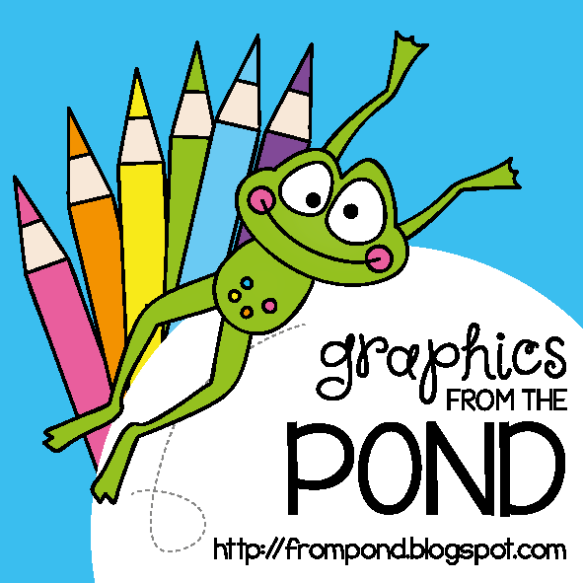
This resource was created by Jennifer Findley. It may be printed and photocopied for single classroom use. It may not be put on the Internet, sold, or distributed in any form. Check out my store for more resources that are common core aligned.
Follow my blog for updates and freebies.
Thanks!
Jennifer Findley
www.JenniferFindley.com

