Slide 1
https://jenniferfindley.com/small-group-reading-management-and-engagement-strategies

Slide 2
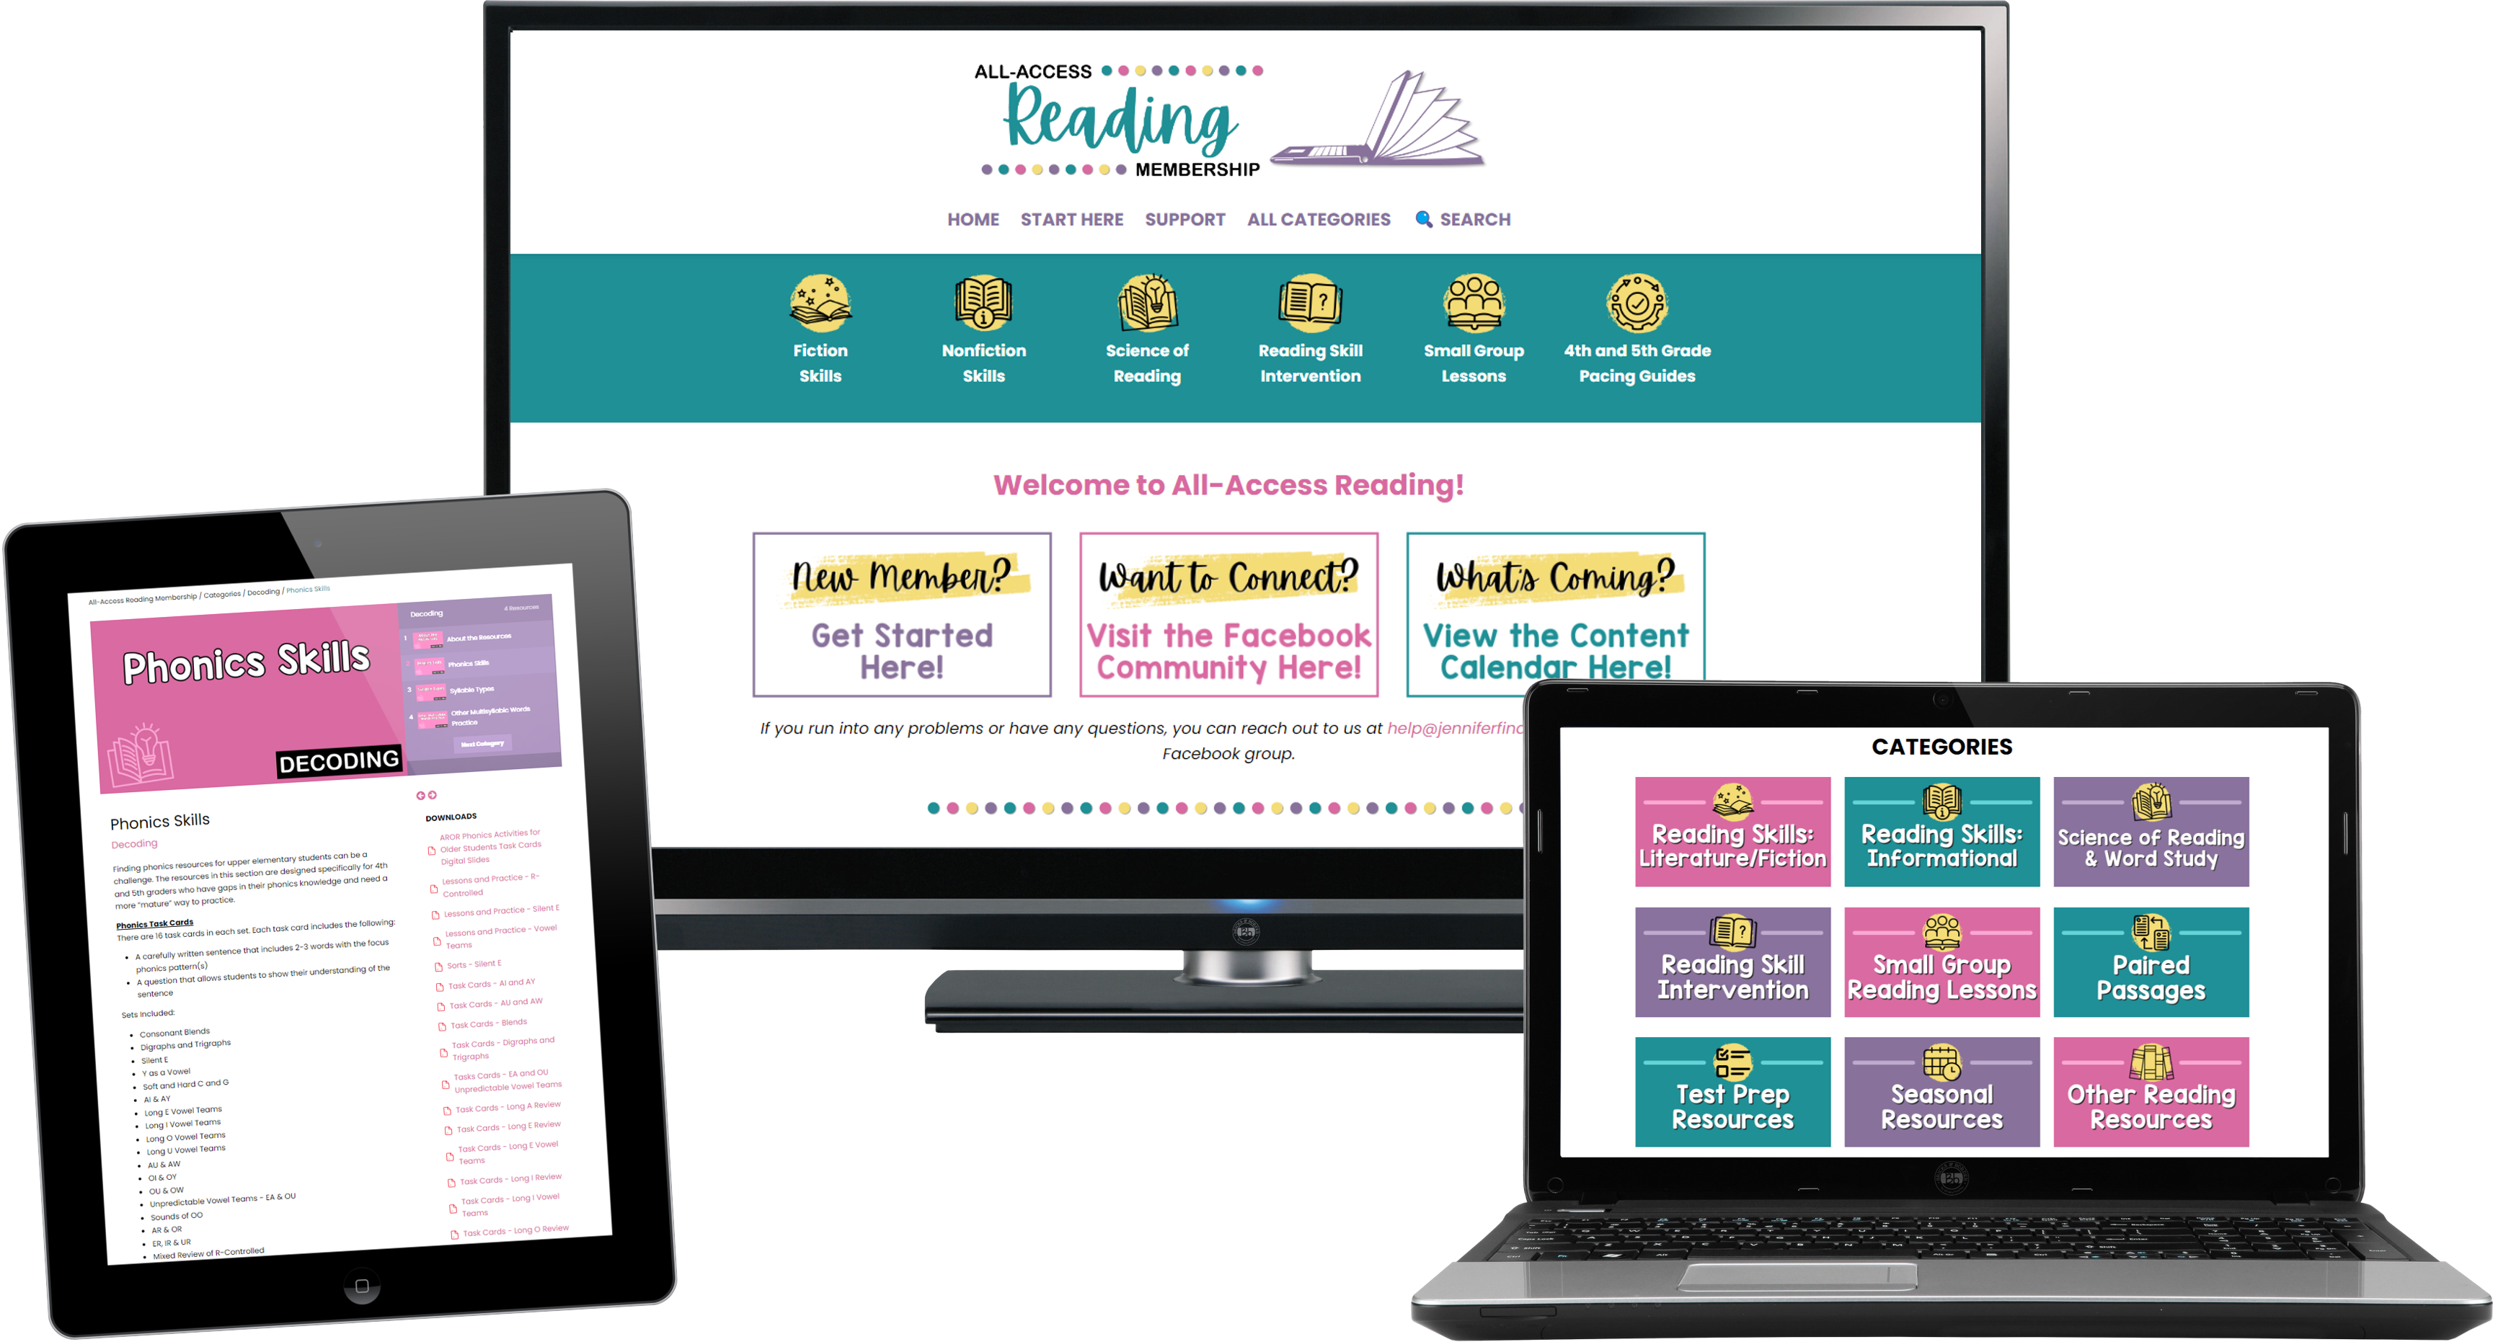
Small Group Reading
(AND THE REST OF YOUR READING!)
Get instant access to a vast collection of reading resources and activities to help you:
implement an engaging and effective small group reading routine
meet the rigorous demands of grade-level standards
reach readers with a wide range of ability levels
engage students with a refreshing variety of tasks and activities
Click here to get started!
Learn more about
ALL-ACCESS READING now!

Slide 3
Be Prompt and Prepared: Always come to the small group on time with all the necessary materials.
Active Listening: When someone is speaking, we listen closely. We do not interrupt or talk over others.
Participation: Everyone has a voice. Share your thoughts, ask questions, but also give others a chance to speak.
Stay on Task: Our small group time is limited, so we need to stay focused on the topic or activity at hand.
Respectful Responses: Agree or disagree with ideas, not with people. Remember to use kind words and body language.
Keep Hands to Yourself: Respect personal space. No touching other people’s belongings without permission.
Quiet Transition: Move to and from your small group quietly, so you do not disturb other groups or the rest of the class.
Use Indoor Voices: Even though we are in a smaller group, we still use our indoor voices to keep the environment conducive to learning for everyone.
Stay Seated: Unless given permission, remain in your seat during the group.
Keep Area Clean: After our group, make sure the area is clean. Pick up any materials and push in chairs.

Slide 4
text

